Slide 1
Team 5
HushHush Recruitment User Story
Big Data Programming
Adhirath Balan Erath
Madhura Bharat Aravendekar
Sheethal Raghavendra
Gurudarshan Bangalore Nagaraju
Chetan Bhilware

Slide 2

User Story for HR
Purpose: As an HR professional at Doodle, I would like to have an automated solution which enhance the efficiency of our candidate selection process by minimizing manual efforts and ensuring confidentiality.
Must have:
It should allow me to set the criteria for the candidate selection within the system. This should include the ability to articulate job roles or skill sets in accordance with the specific requirements.
The system should then automatically filter candidate data based on the established selection criteria.
It should send an invitation to potential candidates to notify him/her about their selection for specific job roles.
It should offer a secure interface to selected candidates to submit their solutions on three coding questions.
Additionally, it should allow to send an interview invitation via application itself.
It should prioritize data privacy and maintain secure validation of coding solutions.
2

Slide 3
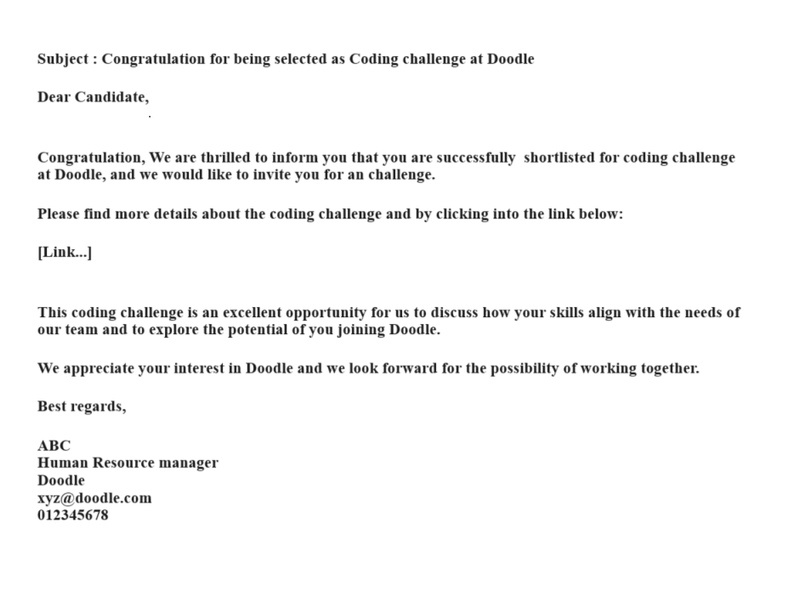
Email template for coding invite
3

Slide 4
USER STORY FOR Technical Recruiter:
Purpose: As a Technical Recruiter, I aim to utilize this new feature to streamline the recruitment process, enabling me to assess the candidate's performance and provide constructive feedback.
Must have:
I wish to receive notifications from the algorithm regarding the invitation list, including candidate details in a document format.
I would like to receive mail/ notification from the algorithm every subsequent step in the recruitment process.
I would like to thoroughly review the coding solutions submitted by candidates and share my personal feedback on the candidate performance. (Time Complexity, Space Complexity and Clean coding)
It is crucial to have the capability to schedule interviews for successful candidates who have completed the challenge.
4

Slide 5
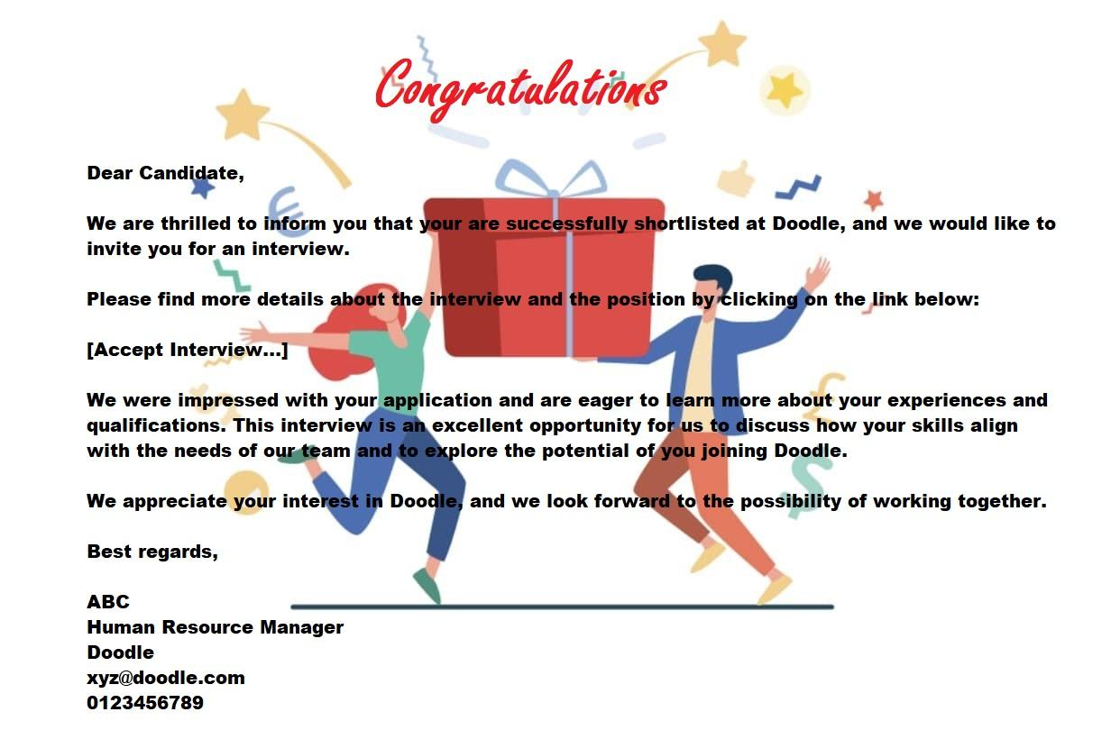
Email Template for interview invite
5

Slide 6
User Story for Candidate
Purpose: As a candidate I would like to experience a smooth selection/hiring process with clear instructions and communications at all points in time. Irrespective of getting hired or given an interview I would like to have a candidate feedback.
Must have:
I would value receiving an invitation from the system informing me of my selection for a coding challenge, along with the option to accept or decline the proposal.
Upon accepting the invitation, I expect to receive a series of programming challenges, each accompanied by a specified time duration within which to solve them.
I expect to get an integrated coding environment for solving the coding challenges.
It would be highly beneficial if I could receive detailed feedback on both my coding mistakes and strengths, providing valuable insights for improvement.
I would appreciate receiving notifications throughout the hiring process, keeping me informed about both progress and any updates relevant to my application.
6

Slide 7
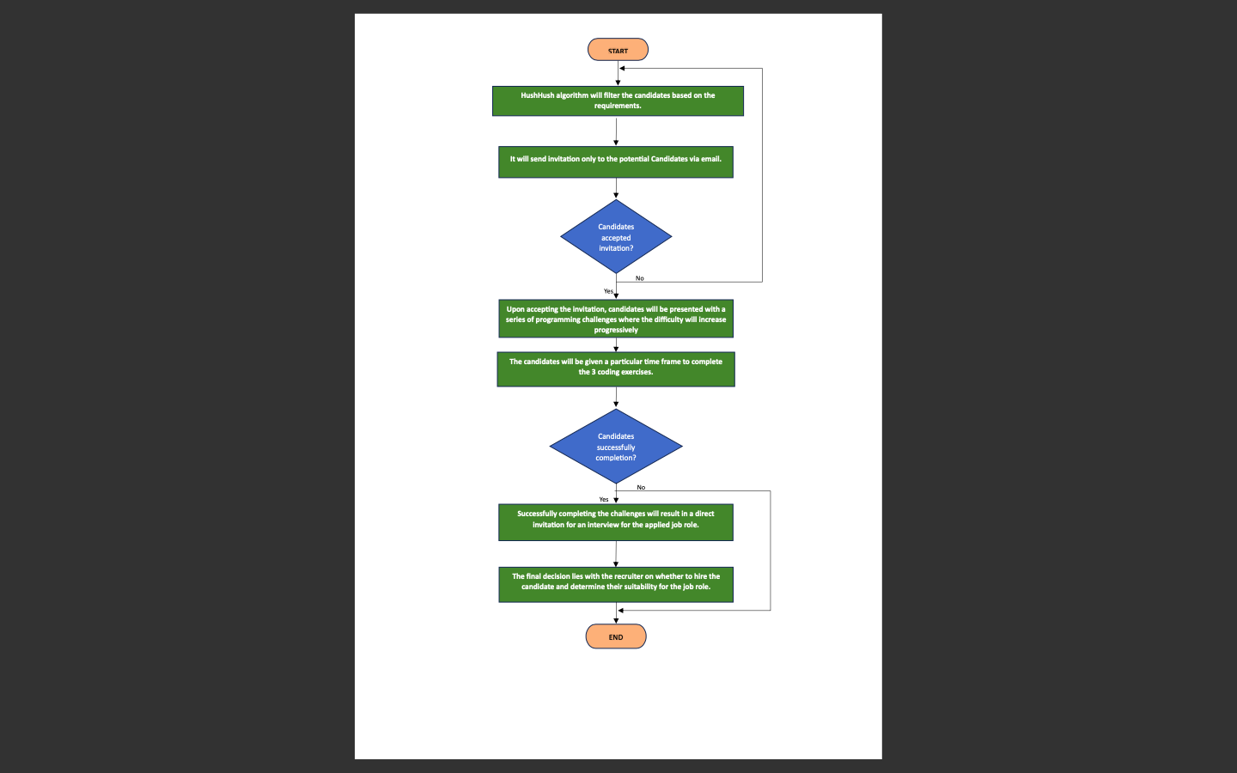
FLOWCHART

Slide 8

Thank you!!
Notes:
fhfhjggjkhvgjngg

